Slide 1
Available Resources from the Ministry Council

Slide 2
But First…Let’s share for a minute
What are some studies and resources you have used in your group?
Bible Studies
Events and fundraisers
Mission work

Slide 3
Pastoral Development Ministry Team
pam@cumberland.org

Slide 4
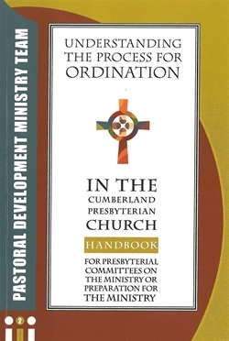
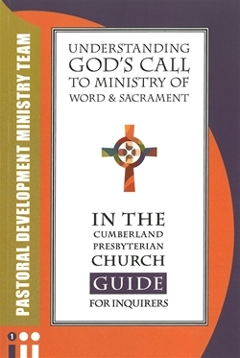
Importance of Helping Ministers

Slide 5
Ways of Honoring Your Minister
Legacy of Ministry Endowment
This Legacy is established in recognition of the faithful and passionate ministries of Samuel McAdoo, Finis Ewing, Samuel King, and Louisa Woosley. These ministers created a legacy of ministry that countless Cumberland Presbyterian ministers have continued down through the years. By participating in this Legacy minister become co-laborers in building up the kingdom of God both now and in the future. Recognition is given to ministers upon their ordination, ordination anniversaries, retirements and in memory. An ordination recognition includes a beautiful pastoral cross pendant.
Clergy Crisis Fund
The purpose of the Clergy Crisis Fund is to provide financial support to clergy who are in crisis and in need of support and care. You or someone you know could benefit from the Fund or you could donate to the Clergy Crisis Fund.
Pastoral Development Ministry Team – Ministry Council of the Cumberland Presbyterian Church (cpcmc.org)

Slide 6
Missions Ministry Team
Milton Ortiz
mortiz@cumberland.org
Kristi Lounsbury
KLounsbury@cumberland.org
Lynn Thomas
lthomas@cumberland.org
TJ Malinoski
TMalinoski@cumberland.org

Slide 7
New Bible Study for Groups and Individuals
Relational Missions, Concepts, Perspectives and Practices That Inform Global Missions explores missions from a relational perspective. Missions is more than going out. It involves developing meaningful intercultural relationships. Missions has a theological foundation which explains why the church sacrificially sends missionaries and invests resources into missions. The Trinity establishes the relational purpose of missions. This book explores ways students of missions can open their eyes to a bigger picture, thus better understanding the challenges the church faces on the mission field. God gave the world a diversity of cultures in order to enrich the church. Lastly, this book looks at some of the practices that allow missionaries and the sending church to develop meaningful and lasting relationships with the nationals they serve. Lynn brings his years of experience as a missionary and mission director, as well as concepts and theories of mission leaders, to shed new light on what it means to do missions.

Slide 8
Bible Study from Lynn Thomas
This Bible study combines scriptures with concepts related to missions from mission leaders. By using scriptures, mission concepts, and church history, this study presents how the church should understand and do missions. The goal of this Bible study is to present a biblical perspective on missions that reflects God’s image. This mission lesson is for those who are or who want to be students of missions. The study helps explain the work of missionaries and the importance of missions to the church. This study is unique, in contrast to other studies about missions, because it explains missions from a relational perspective. Mission provides a way for Christians to connect with other Christians and experience a global family. Missions has the ability to transform lives, not only on the mission field but also the life of the missionary and his or her sending church.

Slide 9
The Missionary Messenger

Slide 10
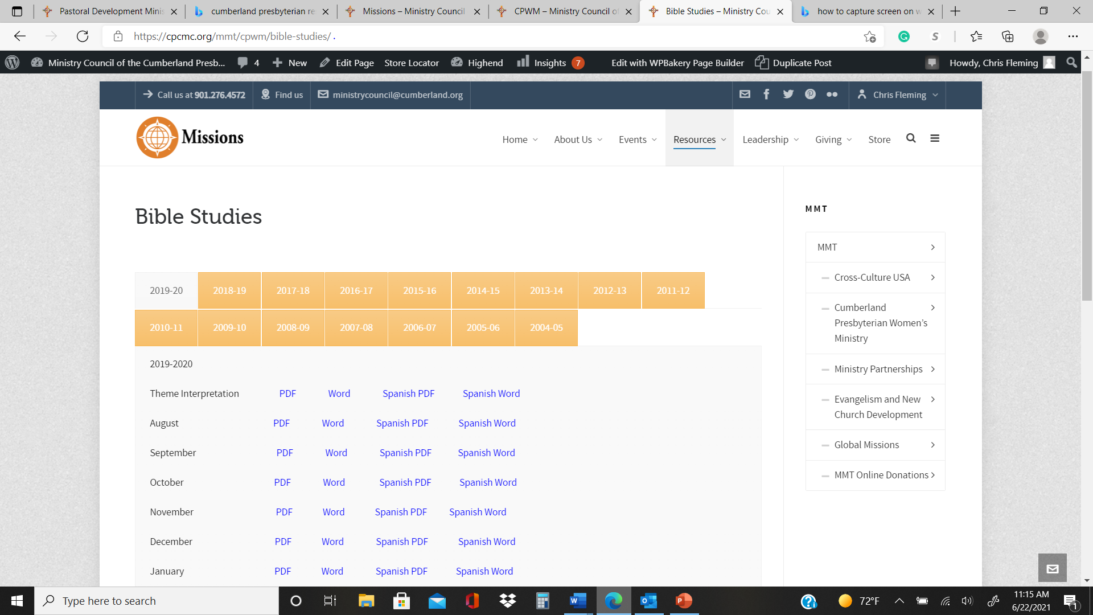
CPW Bible Studies
Bible Studies – Ministry Council of the Cumberland Presbyterian Church (cpcmc.org)

Slide 11
Seasonal Giving Campaigns
The Stott-Wallace Endowment The Stott-Wallace Missionary Offering is the only way the Cumberland Presbyterian Church supports Cumberland Presbyterian Missionaries. Your contribution goes to support their salary and benefits as missionaries.
Gift to the King and the Loaves and Fishes offering
Helps to support various missions work in the denomination

Slide 12
Churches are called to minister to their community but face many challenges. Congregations are growing older, smaller, less diverse, and have fewer resources to minister to a community that continually changes around it. Our churches are asking “How can we minister and witness in these challenging times?” As a response to this question, the Ministry Council and its staff have developed and will implement ENGAGE. The purpose of ENGAGE is to enable churches to provide relevant and authentic ministry and witness to their communities.

Slide 13
Communications Ministry Team
Matt Gore
mhgore@cumberland.org

Slide 14
Planning Calendar
The ever popular planning calendar is also available in a downloadable format. You won't want to miss out on important dates and events in the church or struggle to find the Lectionary readings for the next week, all of which are included in the calendar.
The Calendar will be different this year. It will be a spiral bound planner format

Slide 15
The Cumberland Presbyterian Magazine
The Cumberland Presbyterian Magazine: Informing and entertaining Cumberland Presbyterians since 1829!
The Cumberland Presbyterian is the publication of record for the judicatories of the Cumberland Presbyterian denomination. Published monthly, except November, the Cumberland Presbyterian brings readers news and informative features from across the denomination.
For those attending this workshop you will receive 20% any purchase or subscription to the CP Magazine. Go to the store website
Subscriptions (cumberland.org)
And when ordering use GA2021

Slide 16
Discipleship Ministry Team
Elinor Brown
esb@cumberland.org
Jodi Rush
jrush@cumberland.org
Nathan Wheeler
nwheeler@cumberland.org
Chris Fleming
cfleming@cumberland.org

Slide 17
Discipleship Blueprints
The Discipleship Ministry Team would like to assist you with leadership training:
You select from the designs below (or contact DMT for a custom design).
You set the date in coordination with DMT
We come to you! (or virtual)
A free custom designed event and trainer (must pay for travel expense for trainer)

Slide 18
Discipleship Blueprints – Ministry Council of the Cumberland Presbyterian Church (cpcmc.org)
Reinventing Sunday School: Should we write an obituary or an invitation to the party?
Stewardship, Prayer and Your Gifts
Who Do You Think You Are? Using Family Church and Local History to Reveal Your Family Faith Journey
Your Bible Needs Fixing
Celebrating the Small Membership Church
Curriculum Selection: Priorities, Partners, and Possiblities
Discipleship 101: Helping People Mature in the Faith
Remaining Relevant: Senior Adults and the Church

Slide 19
eVotions
Begin your day with focus. Each day has a Scripture reading, meditation written by many throughout the church, and a prayer.
cpcmc.org/evotions

Slide 21
Children’s Fest
Children’s Fest is virtual in 2021. This means children can attend without traveling long distances. All you have to do is gather the children at your church and tune into Zoom. The day’s activities are planned around two scriptures: Deuteronomy 6: 4 – 9 and Luke 10: 25 – 37. We hope the children of your church will join us on this day to learn more about how Jesus wanted us to love our neighbor!

Slide 22
Cumberland Presbyterian Resources
Cindy Martin
cmartin@cumberland.org
Andy Mclung
amcclung@cumberland.org

Slide 23
Curriculum
The Discipleship Ministry Team has created many resources that you might not know about. So, lets take a look at a few.

Slide 24
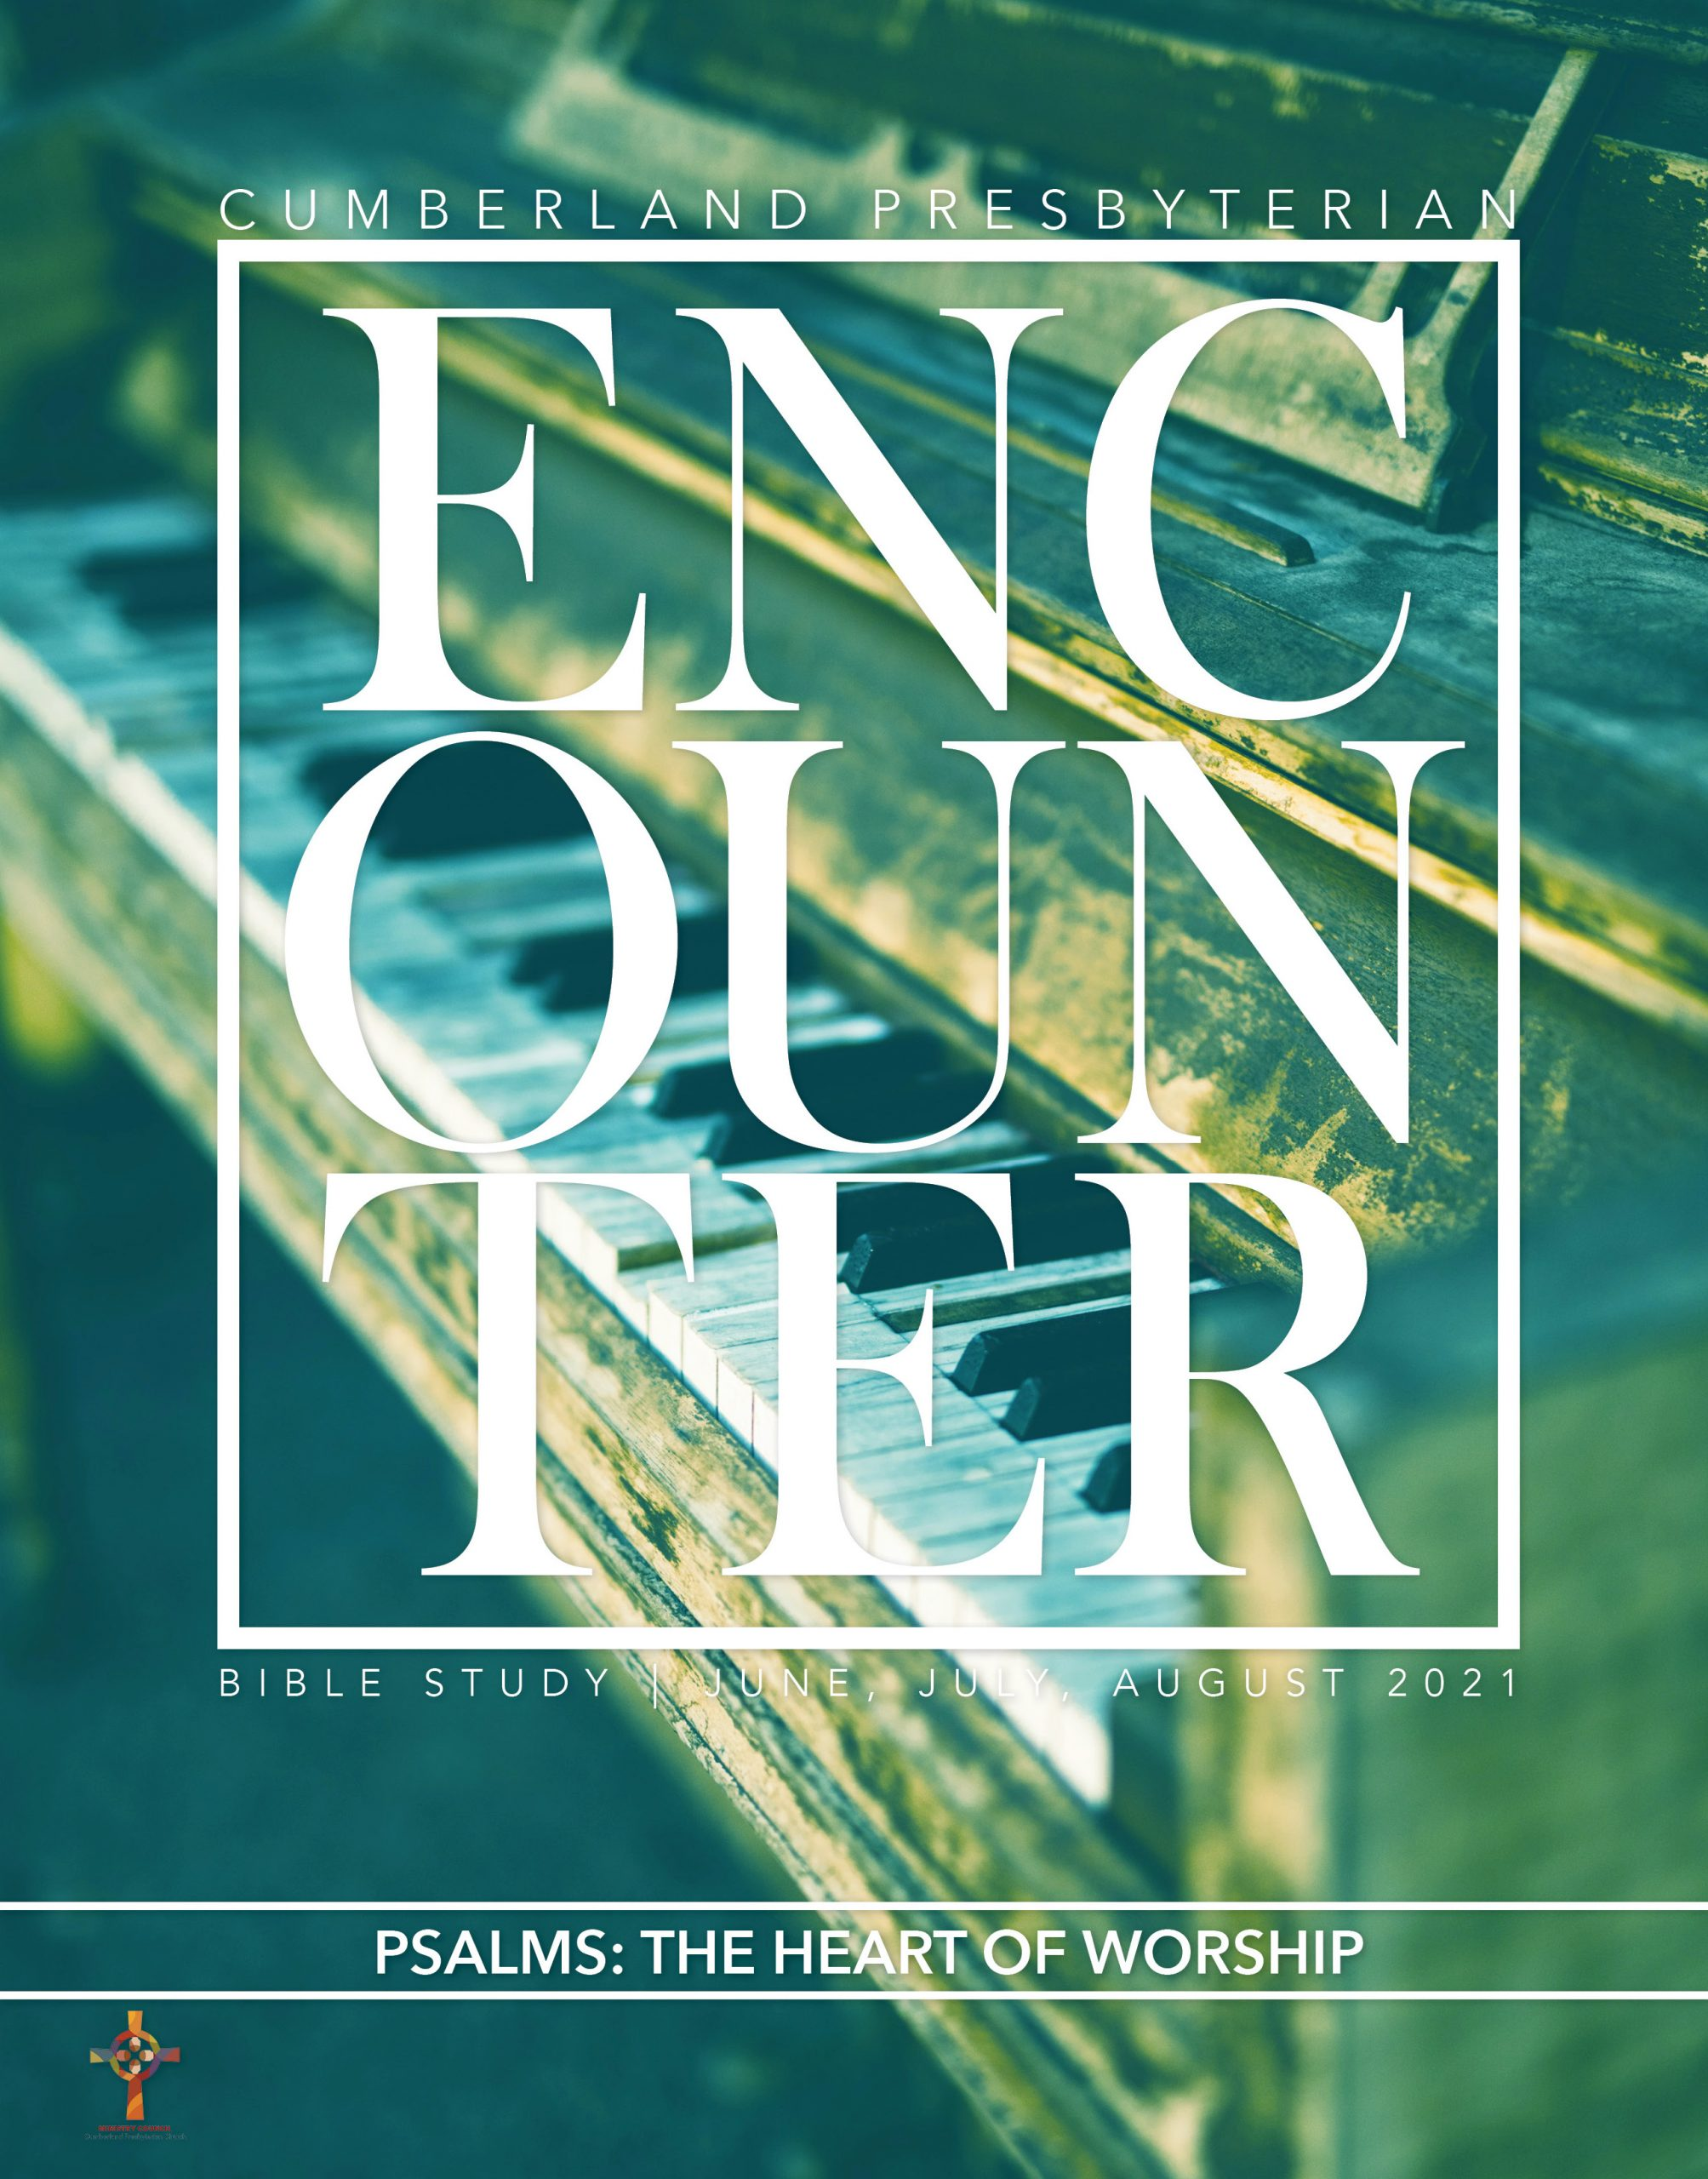
Encounter—Also known as the greatest Christian resource since John wrote the Revelation.
Each lesson is introduced with a discussion question. Then we follow the prescribed method of study of our Confession of Faith.
The lessons model our Confession of Faith 1.07:
In order to understand God’s word spoken and through the scriptures, persons must have the illumination of God’s own Spirit. Moreover, they should study the writings of the Bible in their historical settings, compare scripture with scripture, listen to the witness of the church throughout the centuries, and share insights with others in the covenant community.

Slide 26
Intersections—Journal and Discussion
Intersections: Where Bible and Life Meet is a curriculum resource for adults, written by and for Cumberland Presbyterians. These resources are organized around themes, with each theme being printed as a separate book. Each lesson provides general content of biblical background and context in addition to the Bible story. The content includes conversational questions to aid in facilitation of the lesson discussion. The resources have a strong focus on how to apply the Bible to one’s life. Each lesson contains “daily intersects” that are meant to reinforce the lesson by posing questions for additional thought or action throughout the week. Users are encouraged to use the daily intersects as a journaling activity.

Slide 27
Stir
Stir allows you to pick and choose elements from the curriculum so that you can use it in a multitude of ways. The full Stir curriculum includes:
The Stir leader’s guide contains three lessons with each having three parts designed for you to pick the elements that you want to use and three videos created specifically to be used within each lesson or to be used on their own.
You can purchase Stir curriculum as a full curriculum or just pay for which elements you want to use.
For more information or to purchase contact Nathan Wheeler nwheeler@cumberland.org

Slide 28
Wesources for Lent and Advent
When we say WEsources, we mean a resource for all of us; we have a resource for us no matter our age and number. We wrote this resource especially for leaders to use with children, youth, adults and for you to use as a personal devotion if you so choose.

Slide 29
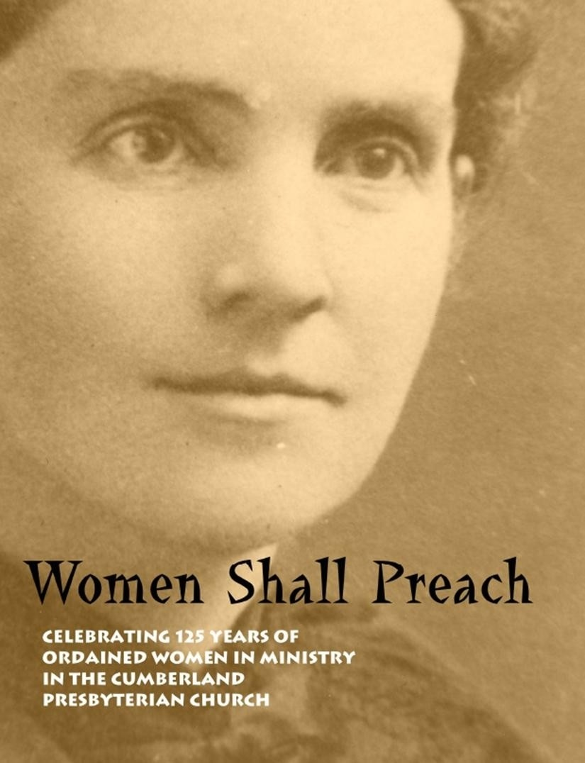
Other Resources from the Store

Slide 30
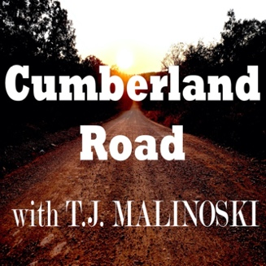
Podcasting

Slide 31
What say you?
I would like to end by asking for your input on new resources that could help you in your ministry or church?

