Slide 1
Denomination Sunday
February 7, 2021
Presentation Created By:
Rev. Rebecca Zahrte
02/01/2021
Notes:
Slideshow Presentation created by: Rev. Rebecca Zahrte.
Shared with permission for the use of the Cumberland Presbyterian Denomination Sunday celebration.

Slide 2
From and To…
1810
Where We Began
1971
Our Church Was Built
2021
Where Are We Going?
Notes:
The Cumberland Presbyterian Denomination began in 1810.
Our current building was completed, and worship began here in 1971.
We are now in 2021-Where are we going as a congregation and as a denomination.
Let’s look at where we have come from and where we are going.

Slide 3
Where We Began
The Cumberland Presbyterian Church is a Presbyterian body formed during the Great Revival
of 1800.
The revival caused disagreement within the Presbyterian Church
February 4, 1810
Cumberland Presbytery became Cumberland Synod in 1813 and, in 1829, when a General
Assembly was established, the Cumberland Presbyterian denomination.
Notes:
The Cumberland Presbyterian Church is a Presbyterian body formed during the Great Revival of 1800.
The revival caused disagreement within the Presbyterian Church (USA) both over the mechanics of the revival and over allowances the pro-revival faction was willing to make in order to secure ministers for its rapidly expanding following.
In two presbyteries, Springfield and Cumberland, the pro-revival faction dominated. These presbyteries, Cumberland in particular, believed the revival to be an extraordinary circumstance which allowed for exceptions to both educational requirements for ordination and the required subscription to the Westminster Confession of Faith.
Both Springfield and Cumberland Presbyteries were members of Kentucky Synod of the Presbyterian Church (USA). In Kentucky Synod the faction opposed to the revival dominated. This anti-revival faction took steps to curtail the activities of the revival-oriented presbyteries. Frustrated, Springfield Presbytery withdrew from the Presbyterian Church in 1803. In 1804, in order to discipline her ministers, Kentucky Synod dissolved Cumberland Presbytery.
On February 4, 1810, at the home of Rev. Samuel McAdow near present day Dickson, Tennessee, McAdow, Rev. Finis Ewing, and Rev. Samuel King reorganized Cumberland Presbytery, previously dissolved by Kentucky Synod of the Presbyterian Church (USA).
These disaffected Presbyterian ministers did not intend to found an independent Presbyterian body. They felt that they would have greater success resolving their differences with Kentucky Synod as an organized body than as individuals. They also felt that the organization of a presbytery would better enable them to serve their congregations.
Growing rapidly, Cumberland Presbytery became Cumberland Synod in 1813 and, in 1829, when a General Assembly was established, the Cumberland Presbyterian denomination became official.

Slide 4
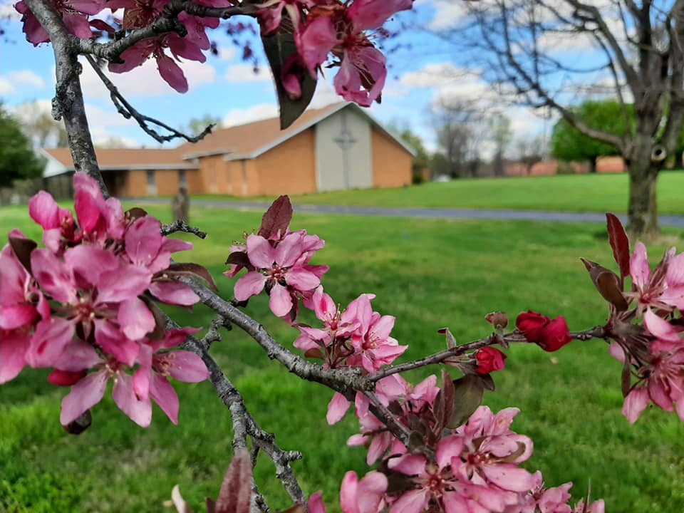
Where Madisonville Began
Organized in 1834
First Building in 1847.
1912 New Location Seminary & West Center
July 1971 Present Location
Notes:
The history of the church is really a history of Cumberland Presbyterians in Madisonville.
The church in Madisonville was organized in 1834 and the first building was erected in 1847. Pressley Prichett was the first settler in Madisonville and owned the corner lot at Federal and Main. This lot was later owned by Frank and Sara Wilkins and deeded to the Madisonville Cumberland Presbyterian Church.
In 1906, by the acts of the General Assemblies of the Cumberland Presbyterian Church and the Presbyterian church in the United States of America, a union was consummated by which the Madisonville church became a Presbyterian USA Church.
A lot on the corner of Seminary and West Center was purchased in 1912 and a contract drawn up for a new Cumberland Presbyterian church building to be constructed the next year. It was dedicated in 1916 and remained in this location for the next fifty-five years.
In July of 1971, the first service was held in a beautiful new Worship Center located on a five-acre track of land in East Madisonville.
The church has had the honor of being in three different Presbyteries. Those Presbyteries are Anderson, Princeton, and now Covenant.

Slide 5
Where Are We Now
Countries we have Presbyteries In
Countries we have CPC Council in and a
CP presence
Notes:
Countries with Presbyteries:
USA: The United States is where the CP Church began. CP Churches can be found in 23 states and there are currently 20 presbyteries in the US. They are Arkansas, Choctaw, Columbia, Covenant, Cumberland, Cumberland East Coast, Del Cristo, East Tennessee, Grace, Hope, Korean Cumberland of SE, Missouri, Murfreesboro, Nashville, North Central, Red River, Robert Donnell, Tennessee-Georgia, Trinity, West Tennessee.
Outside the USA there are 71 Cumberland Presbyterian churches, many mission points, five presbyteries and thousands of Cumberland Presbyterians. We are a global church. All Cumberland Presbyterians are connected by our denominational structure into one church. Our committees, agencies and church leadership consist of participants from all over the world. Our annual General Assembly meeting has delegates from all over the world.
Colombia has 3 presbyteries: Andes, Cauca Valley, and Emaus. There are 39 Churches. There are three schools and two camps.
Hong Kong – Macau 10 Churches. Hong Kong Presbytery consists of ten churches and this presbytery also runs and operates an elementary school and a High School.
Japan has 14 Churches. The largest Cumberland Presbyterian Church in Japan is the Koza Cumberland Presbyterian Church, it has over 580 active members making it one of the larger churches in our denomination.
Countries with a Cumberland Presbyterian Churches
There are eight countries with councils of Cumberland Presbyterian Churches with approx. 1,780 participants
Australia: They have five congregations and seven ministers, and several candidates, licentiates. The work in Australia is Korean.
Brazil: Has one congregation, two new church developments, two ministers, one candidate, and missionaries. The Cumberland Presbyterian Church has a church in Mata de Sao Joao, Brazil. It was a church started to reach Japanese speaking people in this area. The pastor is from Japan Presbytery.
Cambodia: The Cumberland Presbyterian Church has one church in Cambodia and one new church development.
South Korea: Has one congregation, three new church developments, five pastors, two licentiates. The Cumberland Presbyterian Church has a council of churches in South Korea that consists of 5 churches.
Philippines: Has two congregations, three new church developments, three ministers, several probationers, and missionaries. The Cumberland Presbyterian Church has four churches in Iloilo, Philippines. This is an island about 45 minutes by plane from Manila.
Guatemala: Has two congregations, two new church developments, missionaries. The Cumberland Presbyterian Church administers a medical clinic in Guatemala City. We also have three Cumberland Presbyterian churches that are part of the Guatemala Cumberland Presbyterian Council of Churches. We have three missionaries, and we are exploring new church plant opportunities.
Haiti: Has six new church developments, six ministers, and six schools. Hope Presbytery is leading the different ministry efforts in Haiti. There are 6 missions, 6 pastors, and 6 schools.
Mexico: Has two congregations, two ordained ministers, two candidates. The Cumberland Presbyterian Church has a council of three churches, one mission, two missionaries, four pastors in Mexico. Two of the churches and the New Church Development are located in Mexico City, one church is located in Juarez.
Cuba: There are currently five pastors and five house churches. The pastors are involved in the PAS Program.
Spain & France: Revs. Wilson and Diana Lopez are the new missionaries to Spain and France. There are three missions in Spain: Madrid, Bañeres & Zaragoza. One mission in Lyon, France. There are currently 6 candidates.
Closed Countries: The Cumberland Presbyterian Church has missionaries and churches in countries that have restrictions on religious expression. We have churches, outreach ministries, and evangelism efforts in three different closed countries. We do not publish the names of these countries or the people that work there.

Slide 6
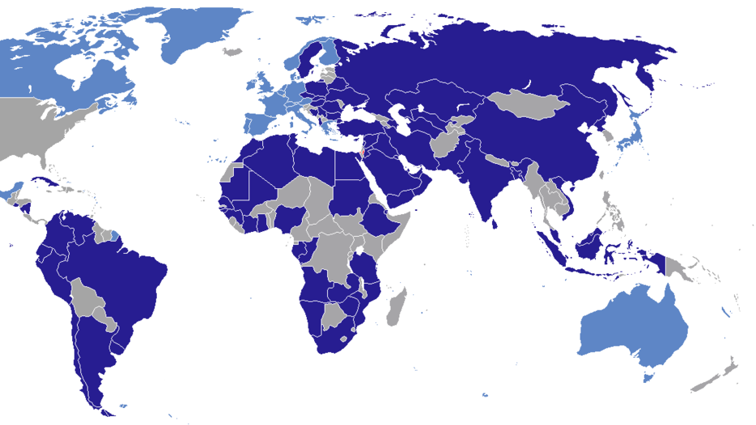
Who Are Our Missionaries
Missions & Missionaries
Notes:
DSL: are husband wife team they are currently located in Southeast Asia. They speak Korean, English, Japanese and Laotian. They are church planters in this closed region of the world.
Josue & Sara Guerrero: Are missionaries in Salvador, Brazil. They are doing language learning and then work on church planting and leadership development.
Daniel & Kay Jang: They speak both Korean and English and are church planters located in Iloilo, Philippines.
Wilson and Diana Lopez: Are our newest missionaries. They speak Spanish, and are church planters in Madrid, Spain.
Fhanor & Socorro Pejendino: Are Spanish speaking missionaries who are church planting and working in Guatemala.
Beth Wallace: Speaks both English and Spanish. She is located in Colombia and works with others on discipleship and leadership development.
Patrick & Jessica Wilkerson: Are church planters and advocates for leadership development who speak both English and Spanish and are located in Medellin, Colombia.
All the missionaries receive a salary for what they do. Their salary is determined by the average wage of a school teacher that is in the region they are located. ALL missionary salaries are paid by the Stott-Wallace Missionary Fund.
Kenneth & Delight Hopson: Are CP missionaries that are associated and funded through World Gospel Missions and currently located in Uganda. Although they are not working through our MMT, we hold them up in prayer as they continue their work for the Kingdom.

Slide 7
What Are Our Missions
Ecumenical work helps educate and
inspire those in impoverished
communities.
Notes:
Beth-El Farmworker Ministry: Wimauma, FL – helps farm workers achieve self-sufficiency through its open opportunities to worship, its extensive educational programs, and the many services it provides helps to meet basic needs. It was started by a group of Cumberland Presbyterians in 1976 and has grown into a multi-faceted ministry today with multiple partners – Tampa Bay and Peace River Presbyteries (PCUSA), and Cumberland Presbyterian Church.
National Farm Worker Ministry (NFWM): a faith-based organization committed to justice for and empowerment of farm workers. NFWM educates, equips and mobilizes member organizations and other faith communities, groups, and individuals to support farm worker led efforts to improve their living and working conditions. NFWM partners with 39 member and supporting organizations. The Missions Ministry Team has a representative on this board.
Project Vida: El Paso, TX – serves three neighborhoods of over 1500 families (located within the nation’s most impoverished neighborhoods). Based on the needs of these low-income neighborhoods, Project Vida has expanded over the years into a multi-faceted center striving to change lives in a holistic and profound way. Programs include low-cost health care (clinics); education (from newborn to 18 years); and economic development (micro-enterprise endeavors); housing (low-cost apartments, transitional housing for homeless single parent families). Board members from del Cristo Presbytery represent the Cumberland Presbyterian Church in this partnership.
Choctaw: Choctaw Presbytery is transitioning from a paid leadership position to empowering the future leaders of the Presbytery. This is being done through leadership trainings and MMT walking by their side for guidance and financial support.
The Coalition for Appalachian Ministry’s: mission is to make a positive impact wherever Reformed tradition and Appalachian culture come together, by networking with church and community, to provide educational and service opportunities. Part of CAM’s ministry is the “craft cabin” which is similar to a social enterprise effort where crafters and artisans have the opportunity to market their craft/art. There are five partners in CAM – Presbyterian Church USA, Reformed Church in America, Christian Reformed Church, Cumberland Presbyterian Church, and Cumberland Presbyterian Church in America. There are board members from Presbytery of East Tennessee, Tennessee/Georgia, Tennessee Synod, Murfreesboro Presbytery, Nashville Presbytery. If you wish to visit the CAM Cabin you can! It’s about a 5 hour trip from here. The cabin is located just outside of Townsend TN. So the next time you are heading to Pigeon Forge make plans to stop by.

Slide 8
What Are Our Local Missions
Ok, we’ve looked at the Denomination-
but what about us?
Notes:
Here at Madisonville First Our Mission is: To Know, Love and Serve God, its church members and those in the wider community.
We have done that in many ways over the past years. Currently we help by collecting both food and non-food items as well as monetary donations to the Food Bank where it is much needed. We also continue to support the Children’s Home in Denton, Texas.
We donate money, time and items to local organizations like:
The Salvation Army
Jesse Stuart Elementary School
Habitat for Humanity
Door of Hope
Triangle House-Women’s Recovery Home
Sacred Sparks Ministry
We support our local Law Enforcement and Fire Departments, by thanking them with Christmas Gift Cards.
We have begun a card ministry, letting community members know that we are praying for them and their families during this difficult season.
Hooks & Needles is a part of us and has made and has donated items to:
West Hopkins & Jesse Stuart schools
The VA Home in Hanson
Brighton Cornerstone
Salvation Army
Door of Hope
Oak Ridge Assisted Living
Sacred Sparks Ministry
Christian Food Bank
Triangle House
Ridgewood
Water With Blessings
Mahr Cancer Center
NHC-Now Madisonville Health & Rehab
Our latest endeavor is to begin a pollinator garden, which has been planted. We will have a 1-acre field full of wildflowers that will attract birds, butterflies and bees. Caring for God’s smaller creations.
And I know there are many organizations within our community that you all personally believe in and donate your time/money and talents to.

Slide 9
Where Are We Going
What is in our future?
Notes:
We are growing! Our denomination is growing the fastest in the cross-cultural communities, especially within the Hispanic and Latino population. Where at one time we were sending missionaries to Colombia, now Colombia is sending missionaries to other nations.
Currently, the Cumberland Presbyterian Denomination is looking for ways to partner with other organizations. Many hands make light work, and ecumenical endeavors reach more than we could alone.
Rev. TJ Malinoski is working with several different “worshipping communities.” What is a worshipping community? Well, it is for those who do not know Christ, for those who want to know Christ, and for those who already know Christ and need a community to worship. A Worshiping Community meets when and where it is feasible to create a space where one gets to pray, to have Bible study, to worship, to share gifts, and to get involved in the needs of the community. Whether you are a seasoned minister, a student or a committed disciple of Jesus Christ, a Worshiping Community helps provide as many people as possible to hear the gospel of Christ, allowing you to lead from your strengths.
TJ has also begun a new podcast called “Cumberland Road,” where each week he interviews a different CP to talk about their unique faith journey. Showcasing how God uses all of us no matter where we have come from or what we have been through.
Our denomination is involved in writing curriculum for all ages with the adult study you are already familiar with called “Encounter.” Of which it has been reformatted and is endeavoring in new ways to reach people through podcast and YouTube publications.
We also have children and youth curriculum’s all of which are designed to deepen our faith and understanding. Helping us into a deeper study of Scripture.
Leaders at the Denominational Headquarters like Jodi Rush and Rev. Nathan Wheeler organize events for our kids and young adults. There are several Children’s Fest locations, where our younger children can connect with other CP’s, making lifelong friendships and learn about God. Rev. Wheeler picks up where Jodi leaves off continuing building upon and encouraging deeper friendships and spiritual growth through programs like CPYC and Kaleo. CPYC is a weeklong camp held at Bethel University each summer, where our kids grow and are exposed to our University system. Kaleo is an amazing opportunity for our high schoolers to spend a 12-month journey with a mentor discerning what path God is calling them to. And this is more than for just ministry students! Maybe you feel called to nursing or teaching or music, whatever it is this program can help point our young adults in the right direction.
Rev. Nathan Wheeler is brand new to the recording industry. He has been writing music for himself and his personal prayer time for many years but has recently branched out. His music can be found at nathanwheelermemphis.bandcamp.com
For the local church context Rev. Kristi Lounsbury & Rev. Dr. Chris Fleming are working on a program called “Engage.” Many Cumberland Presbyterian churches, although small want to thrive and do vital work inside their doors and out in the community. The Engage program will provide leadership, guidance, education and resources for congregations to move forward in their ministry. Engage will allow congregations to discern their mission within its four walls, as well as outside the four walls, in the community in which they serve. Through guided encounters and trainings, the congregation will become spiritually, physically, financially, and numerically engaged in the work of the church and become a thriving congregation.
Locally, what are we doing? We are striving to be the hands and feet of Christ right here in our hometown. As you have already heard we partner with many different organizations to promote, and help in the missions they are already involved in. This year the first Sunday of every month, like it was done today, will have a different organization highlighted and ways in which we can support them.
Our Mission here at Madisonville is to Know, Love and Serve God its church members and those in the wider community.
God’s Kingdom is growing, and it is through the work of His faithful servants with prayer, discernment and action that we see the work being done. The future for the Cumberland Presbyterian Denomination and this church here in Madisonville is bright. I look forward to seeing what God has planned and being able to be a part of that plan for the future of all God’s creatures. Happy Denomination Sunday!

