Slide 1
2011 Women’s Ministry Convention

Slide 3
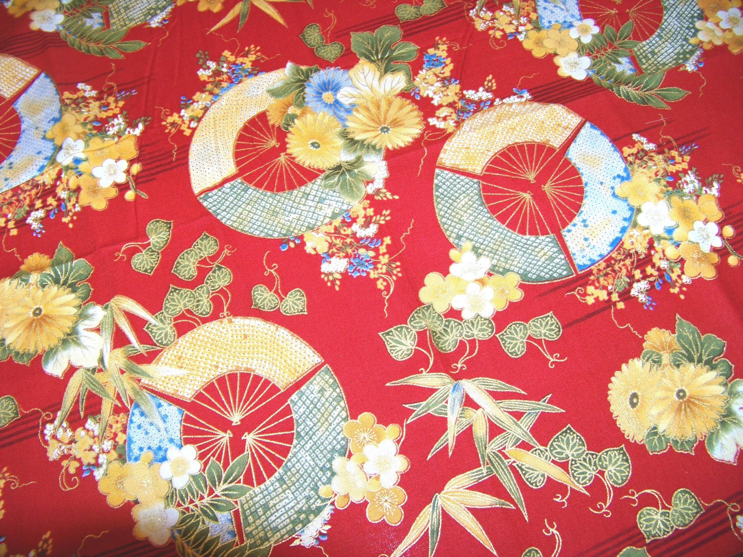
Some have come from the east

Slide 4
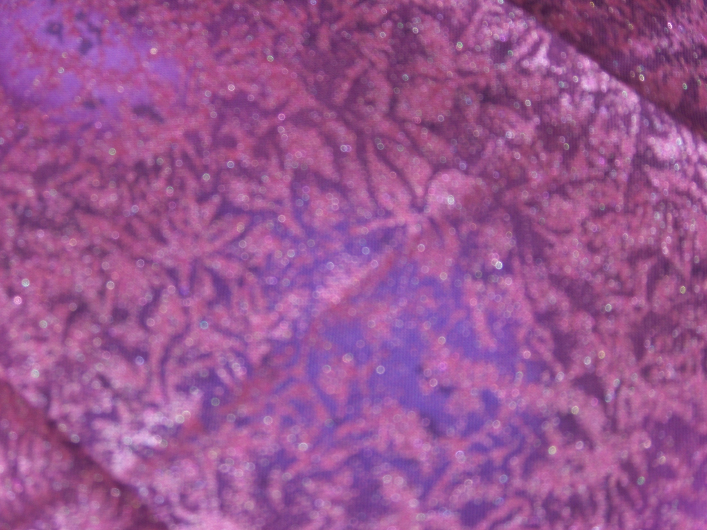
Some have crossed mountains

Slide 5
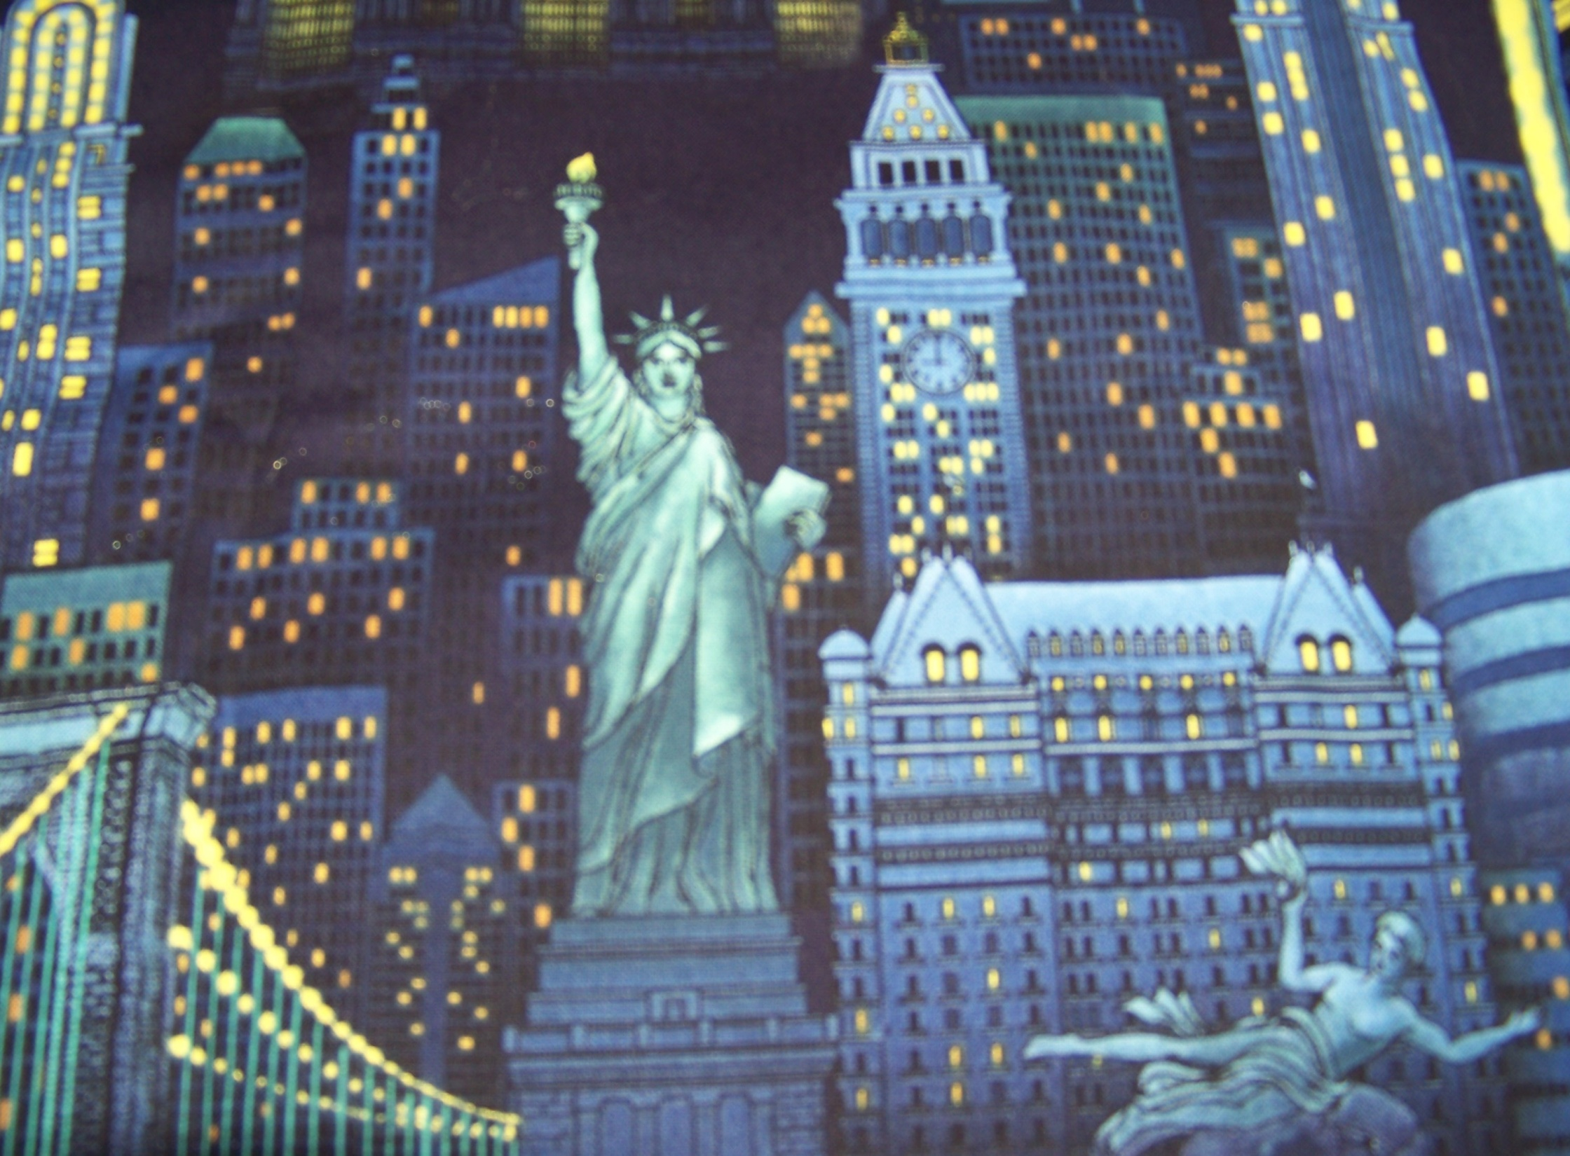
Some have come from the city

Slide 6
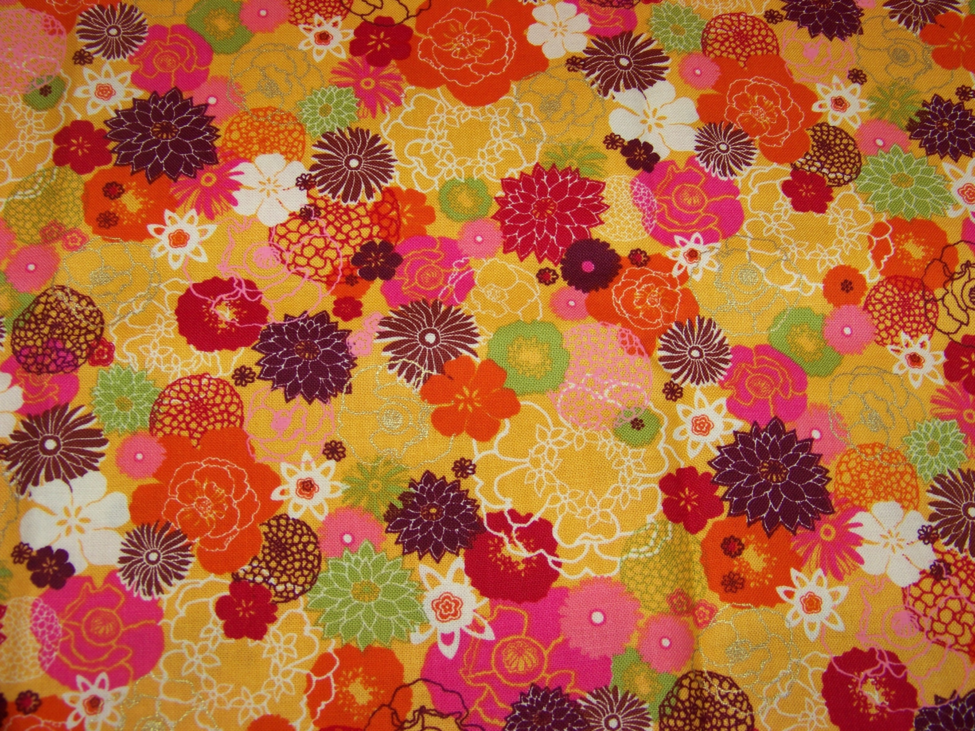
Some have come from hot, flowery lands

Slide 7
Some have crossed oceans

Slide 8
Some have crossed bridges

Slide 9
Some have crossed
treacherous ground

Slide 10
Some have come from wet,
marshy lands

Slide 11
Some have crossed prairies

Slide 12
We have come together from many different places and have traveled many paths with God as our guide

Slide 14
This year’s banner is also a prayer quilt. Prayer quilts are used to promote intercessory prayer.
Each Knot Represents a Prayer
The idea behind this is simple. A heavy thread is used to take stitches through the quilt layers, and the ends are left free to be tied with a square knot. As each knot is tied, a silent prayer is said for someone in special need, who then receives the finished quilt.

Slide 15
Please take a moment during your time at convention to visit the banner and tie a knot.
As you do, please pray the following both for individuals and our church as a whole:
For trust in God as our Guide on our daily path
To continue to seek God’s truth and direction through all that we do
For safe travel for those as they return on their paths to the local churches
Teach us (me) your ways, for our Hope is in You

Slide 16
Prayer Squares
Prayer squares are just very small quilts but have the same big impact.
Please feel free to take a prayer square with you:
to pray/give for someone specific
to share the idea with a group
to promote prayer within a group.
Those interested in the Prayers & Squares
ministry can go to www.prayerquilt.org for details.

